Slide 1


Green Pace
Security Policy Presentation
Developer: Steven Davis
Notes:
Hello, my name is Steven Davis, and this is my presentation for CS 405 Project Two: Security Policy for Green Pace. In this presentation, I will walk through our secure development policy, explain key vulnerabilities, and demonstrate how we use testing and automation to reduce security risks.

Slide 2

OVERVIEW: DEFENSE IN DEPTH
The Green Pace Secure Development Policy establishes mandatory secure-coding standards to prevent common vulnerabilities, reduce breach risk, and implement multiple protective layers while putting security first.
Notes:
The Green Pace Secure Development Policy is designed to prevent common vulnerabilities and reduce the risk of security breaches. It follows a defense-in-depth strategy, meaning we apply multiple layers of security rather than relying on a single control.
This policy ensures that secure coding practices are consistently applied across the development team and that security is integrated into every phase of development.

Slide 3
THREATS MATRIX
High-risk issues (null derefs, buffer overflows, unchecked allocations, pointer-ownership errors, concurrency races) can cause crashes, corruption, or code execution. Medium/low risks (enum casts, missing returns, lifetime mismatches, exception slicing, reserved identifiers) cause undefined or subtle bugs and are preventable with checks and coding conventions.
Likely STD-002 — EXP34-C STD-003 — STR50-CPP STD-005 — MEM52-CPP STD-008 — MEM56-CPP | Priority STD-002 — EXP34-C STD-003 — STR50-CPP STD-008 — MEM56-CPP STD-010 — CON52-CPP
Low priority STD-007 — ERR61-CPP STD-009 — DCL51-CPP | Unlikely STD-001 — Int50-CPP STD-006 — EXP35-C
Notes:
The threats matrix identifies vulnerabilities and categorizes them by risk level.
High-risk issues include null-pointer dereferences, buffer overflows, memory allocation failures, pointer-ownership errors, and data races. These can lead to crashes, data corruption, or even remote code execution.
Medium-risk issues include missing return values and enum casting errors, which can cause undefined behavior.
Low-risk issues include reserved identifiers and minor coding inconsistencies, which can still cause maintainability and reliability problems.
This matrix helps prioritize which vulnerabilities to address first.

Slide 4
10 PRINCIPLES
Validate Input Data — STD-001, STD-002, STD-003, STD-005, STD-010
Heed Compiler Warnings — STD-004, STD-006, STD-007, STD-009
Architect & Design for Security — STD-001, STD-005, STD-008, STD-010
Keep It Simple — STD-003, STD-007, STD-009
Default Deny — STD-002, STD-004, STD-005
Least Privilege — STD-001, STD-008, STD-010
Sanitize Data Sent to Other Systems — STD-001, STD-002, STD-003
Defense in Depth — STD-002, STD-003, STD-005, STD-008, STD-010
Effective QA (testing & review) — STD-001 through STD-010 (all standards)
Adopt Secure Coding Standard — STD-001 through STD-010 (formal baseline)
Notes:
Our policy is built on 10 guiding security principles.
These include validating input data, heeding compiler warnings, designing for security, keeping systems simple, using default deny, enforcing least privilege, sanitizing outputs, applying defense-in-depth, ensuring effective quality assurance, and adopting secure coding standards.
Each principle is directly mapped to one or more coding standards, ensuring that our practices are both consistent and enforceable.

Slide 5
CODING STANDARDS
STD-001-CPP: Int50 — Don’t cast to out-of-range enum
STD-002-CPP: EXP34 — Do not dereference null pointers
STD-003-CPP: STR50 — Buffer/ string correctness
STD-004-CPP: MSC52 — Return value on all paths
STD-005-CPP: MEM52 — Handle memory allocation failures
STD-006-CLG: EXP35 — Temporary lifetime rules
STD-007-CPP: ERR61 — Catch exceptions by reference
STD-008-CPP: MEM56 — Smart pointer ownership
STD-009-CPP: DCL51 — Avoid reserved identifiers
STD-010-CPP: CON52 — Prevent data races on bit-fields
Notes:
The coding standards are prioritized based on risk.
High-priority standards include preventing null pointer dereferencing, handling memory allocation failures, and avoiding buffer overflows, because these can lead to severe vulnerabilities.
Lower-priority standards, such as avoiding reserved identifiers, are still important but have less immediate impact on system security.
This prioritization ensures that developers focus first on the most critical risks.

Slide 6
ENCRYPTION POLICIES
Encryption at rest - This policy applies to databases, file systems, and backups to ensure that sensitive data remains secure and protected, using strong encryption algorithms such as AES-256.
Encryption in flight - This policy protects data in transit as it moves across networks and applies to all communications between clients, servers, and APIs, helping prevent Man-in-the-middle attacks.
Encryption in use - This policy applies when handling highly sensitive data to prevent exposure during computation and encrypting data during processing.
Notes:
Our encryption strategy covers data at rest, in transit, and in use.
For data at rest, we use strong encryption such as AES-256 to protect stored data.
For data in transit, we use secure communication protocols like TLS to prevent interception and man-in-the-middle attacks.
For data in use, we protect sensitive information during processing to minimize exposure.
It’s important to note that encryption is only as strong as its key management, so secure storage and rotation of keys are also critical.

Slide 7
TRIPLE-A POLICIES
Authentication - This policy applies to user logins and system access points, ensuring all users are authenticated using passwords and multi-factor authentication.
Authorization - This policy applies to database changes, file access, and system operations, using least privilege and role-based access control.
Accounting - This policy applies to logging all user activity, such as file access and system changes, for auditing and compliance purposes.
Notes:
The Triple-A framework includes authentication, authorization, and accounting.
Authentication ensures that only verified users can access the system, using passwords and multi-factor authentication.
Authorization controls what users are allowed to do, using role-based access control and the principle of least privilege.
Accounting involves logging and monitoring user activity to ensure accountability and support auditing and compliance.
Together, these controls help protect system access and track usage.

Slide 8
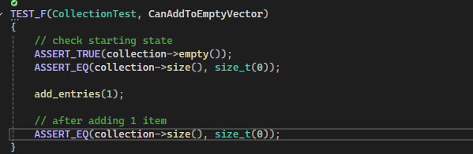
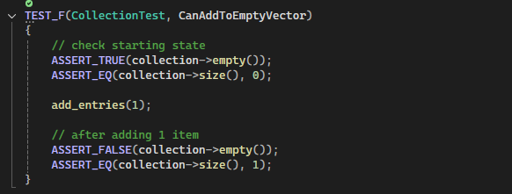
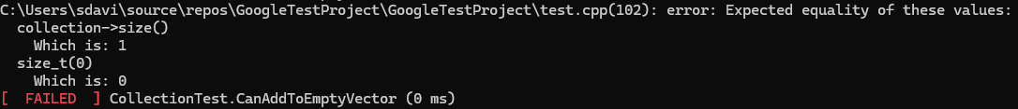
Unit Testing
CanAddToEmptyVector – STD-008
Add_entries not modifying collection, misuse of assumption, incorrect pointer handling.
Fix by ensuring add_entries pushes elements and ownership remains with fixture.
Notes:
This test verifies that entries are correctly added to a collection.
The issue identified was incorrect pointer handling and assumptions about how the function behaves.
We fix this by ensuring elements are properly pushed and ownership is handled correctly.
To improve further, we can add boundary tests and automate regression testing.

Slide 9
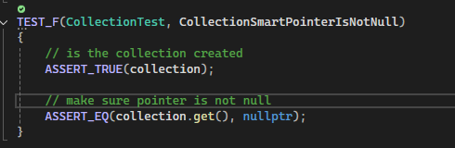
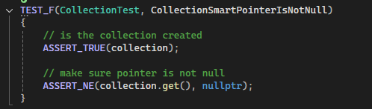
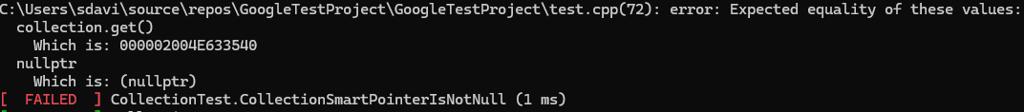
Unit Testing
CollectionSmartPointerIsNotNull – STD-002
The Code here shows a simulated null derefence condition, a missing null check risk.
Fixed by ensuring collection initialization and null checks before dereference.
Notes:
This unit test checks that a collection using smart pointers is not null.
The vulnerability here is a potential null pointer dereference.
We fix this by ensuring proper initialization and adding null checks before accessing the pointer.
To take this further, we can integrate this test into the CI pipeline and combine it with static analysis tools to automatically catch similar issues.

Slide 10
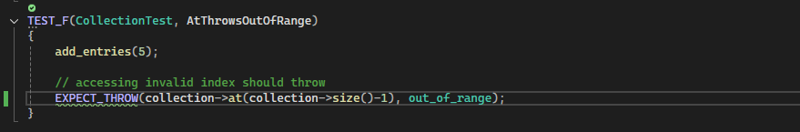
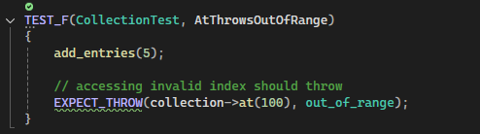
Unit Testing
AtThrowsOutOfRange – STD-003
Fixed by using proper index checks or catch the exception.
No exception for out-of-range index
Notes:
This test checks for out-of-range errors when accessing elements.
The vulnerability is the lack of exception handling for invalid indices.
We fix this by adding proper checks and exception handling.
To go further, we can implement fuzz testing to simulate unexpected inputs and ensure robustness.

Slide 11
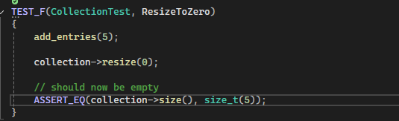
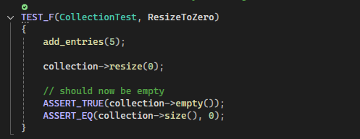
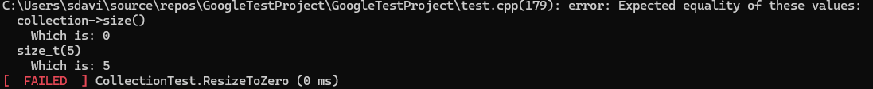
Unit Testing
ResizeToZero – STD-005
Post-resize size/capacity state assumed incorrectly.
Fix by correctly handling resize results and checking allocation where relevant.
Notes:
This test verifies behavior when resizing a collection to zero.
The issue was incorrect assumptions about size and capacity.
We fix this by properly handling resize operations and checking memory allocation.
To enhance this, we can use memory sanitizers like AddressSanitizer to detect memory-related issues.

Slide 12

AUTOMATION SUMMARY
Automation will be used to enforce and ensure compliance with the standards defined in this policy.
Automation will be embedded throughout the DevSecOps lifecycle to enforce compliance with secure coding standards. During the Plan and Create phases, developers will use IDE plugins such as SonarLint to detect vulnerabilities in real time. In the Verify phase, static application security testing tools like SonarQube and CppCheck will scan for vulnerabilities and insecure dependencies. In the Pre-Production phase, Dynamic Application Security testing tools will identify runtime vulnerabilities. During the release, code signing ensures integrity. In the Detect and Respond phases, monitoring tools like runtime application self-protection will provide continuous security monitoring. This ensures compliance and supports a defense-in-depth strategy.
already has a well-established DevOps process and infrastructure.
Notes:
Security automation is integrated throughout the DevSecOps lifecycle.
In the planning phase, we perform threat modeling.
During development, we use IDE tools like SonarLint to catch issues early.
In the build phase, compilers and static analysis tools scan the code.
During testing, we run unit tests and sanitizers.
Before deployment, we use dynamic testing and fuzzing.
In production, we monitor systems using runtime protection and logging tools.
This continuous integration of security ensures vulnerabilities are caught as early as possible.

Slide 13
TOOLS
Plan: threat modeling, track security work (Jira/GitHub).
Create: IDE checks & linters (SonarLint, clang-tidy, Cppcheck).
Verify/CI: build, unit tests, SAST, sanitizers (GoogleTest, CodeSonar, ASan/UBSan) — fail on critical findings.
Pre‑prod: DAST & fuzzing (OWASP ZAP, libFuzzer) and dependency scans (Snyk).
Release/Operate: image scans, code signing, runtime monitoring (Trivy, SBOM, SIEM, RASP).
Notes:
This slide shows the tools used across our DevSecOps process.
In the planning phase, we use tools like Jira and GitHub for threat modeling and tracking security work.
During development, developers use tools like SonarLint, clang-tidy, and Cppcheck to detect issues in real time.
In the verify and CI phase, we run builds, unit tests, and static analysis tools like CodeSonar, along with sanitizers such as AddressSanitizer and UndefinedBehaviorSanitizer.
In pre-production, we use OWASP ZAP, libFuzzer, and dependency scanning tools like Snyk to find runtime and input-based vulnerabilities.
Finally, in release and operations, we use tools like Trivy, SIEM systems, and runtime protection to monitor and maintain security.

Slide 14
RISKS AND BENEFITS
Problems to Solutions: high-risk bugs (nulls, overflows, ownership, races) should enforce standards, SAST, unit tests, sanitizers.
Acting now: fewer breaches, lower fix cost; if you wait: exploits, higher remediation and compliance risk.
Lacking: CI enforcement for ownership/concurrency checks and runtime protection, causing issues later in development.
Strategy risks: tool noise and upfront cost can be much, but are mitigated with phased rollout, and tuning will save money down the line.
Notes:
Addressing vulnerabilities early reduces the risk of breaches and lowers the cost of fixing issues.
If we act now, we improve system security and reduce long-term maintenance costs.
If we delay, vulnerabilities may be exploited, leading to higher costs, legal risks, and damage to reputation.
While implementing security tools may require upfront effort, the long-term benefits outweigh the risks.

Slide 15
RECOMMENDATIONS
Incomplete CI enforcement for ownership, allocation, and concurrency rules.
Add SAST rules, sanitizer builds, and CI gating for MEM56/MEM52/CON52.
Limited developer training and secure templates.
Mandatory secure-coding training, secure project templates, and checklist-driven reviews
Notes:
There are still gaps in the current policy.
We need stronger CI enforcement for memory management and concurrency issues.
We should also implement mandatory developer training and secure coding templates.
Looking forward, adopting advanced practices such as zero-trust architecture and continuous security monitoring will help prevent future threats.

Slide 16
CONCLUSIONS
SEI CERT C++ secure coding rules
CWE (common weakness enumeration) for threat mapping and tests
C++ Core Guidelines for modern safe C++ patterns
Cyptography & key-management standards
Notes:
This security policy establishes a strong foundation for secure coding and system design.
By applying industry standards, automated testing, and a defense-in-depth approach, we can significantly reduce vulnerabilities.
Real-world incidents, such as major data breaches caused by unpatched vulnerabilities, highlight the importance of proactive security measures.

Slide 17
REFERENCES
Software Engineering Institute, Retrieved April 18, 2026. SEI CERT C++ Coding Standard. https://cmu-sei.github.io/secure-coding-standards/sei-cert-cpp-coding-standard/
Microsoft, Retrieved April 19, 2026. Security Best Practices for C++ https://learn.microsoft.com/en-us/cpp/security/security-best-practices-for-cpp?view=msvc-170&viewFallbackFrom=vs-2019
Robert C. Seacord, September 2005. Secure Coding in C and C++. https://learning.oreilly.com/library/view/secure-coding-in/9780768685923/?sso_link=yes&sso_link_from=SNHU

